Slide 1
Case study MAJIC
Jiyang 16Dec2024

Slide 2
Outline
Linear model result (for log odds ratio)
use all covariate
use haemoglobin (imbalanced in ET)
use sex + JAK2
use sex + JAK2 + haemoglobin
Logistic model result and the convergence status using MCMC plot
use all covariate
use haemoglobin (imbalanced in ET)
use sex + JAK2
use sex + JAK2 + haemoglobin
Subgroup analysis to see whether treatment effects are different between these variables
Multivariable logistic regression to compare with the result in published paper

Slide 3
Log odds ratio generating (PV)
Use the fitted logistic model to calculate the logit value (log odds ratio).
logit=intercept+treatment*log(2.03)+age*log(1.01)+haemoglobin*log(1.02)+therapy*log(0.77)+sex*log(0.97)+thrombosis*log(0.63)+intolerant*log(0.94)+ intoresis*log(0.7)+splemomegaly*log(0.13)+splenectomy*log(1.26)+error
Intercept is the overall log odds ratio: log(63/117)
Each covariate (including treatment) is centered.
Gaussian error term with signal-to-noise equals 10.

Slide 4
Linear result (haemoglobin)

Slide 5
Linear result (sex + JAK2)

Slide 6
Linear result (sex + JAK2 + haemoglobin)

Slide 7
Linear result (all)

Slide 8
BACK UP
21Nov2024

Slide 9
Study introduction
MAJIC is a randomized, phase II trial evaluating the longterm comparative safety and activity of ruxolitinib versus Best Available Therapy (BAT) in two different populations (HC-INT/RES ET and PV)
Indications: patients with Polycythaemia Vera (PV) or Essential Thrombocythaemia (ET) who have met criteria for resistance or intolerance of hydroxycarbamide (HC) therapy
Target: JAK2
PV is driven by JAK2 mutations, especially JAK2V617F mutation.
ET’s mutations (JAK2V617F, MPL, CALR mutation ……) also led to increased JAK2 signaling.
Ruxolitinib is the JAK1/2 inhibitor
Treatment assignment
 | PV (stratified by sex) | ET (stratified by JAK2m)
Treatment (Rux) | 93 | 58
Control (BAT) | 87 | 52

Slide 10
Outcome
Primary outcome: complete response (CR) rate within 1 year
 | PV | ET
Treatment | 40/93 | 27/58
Control | 23/87 | 23/52

Slide 11
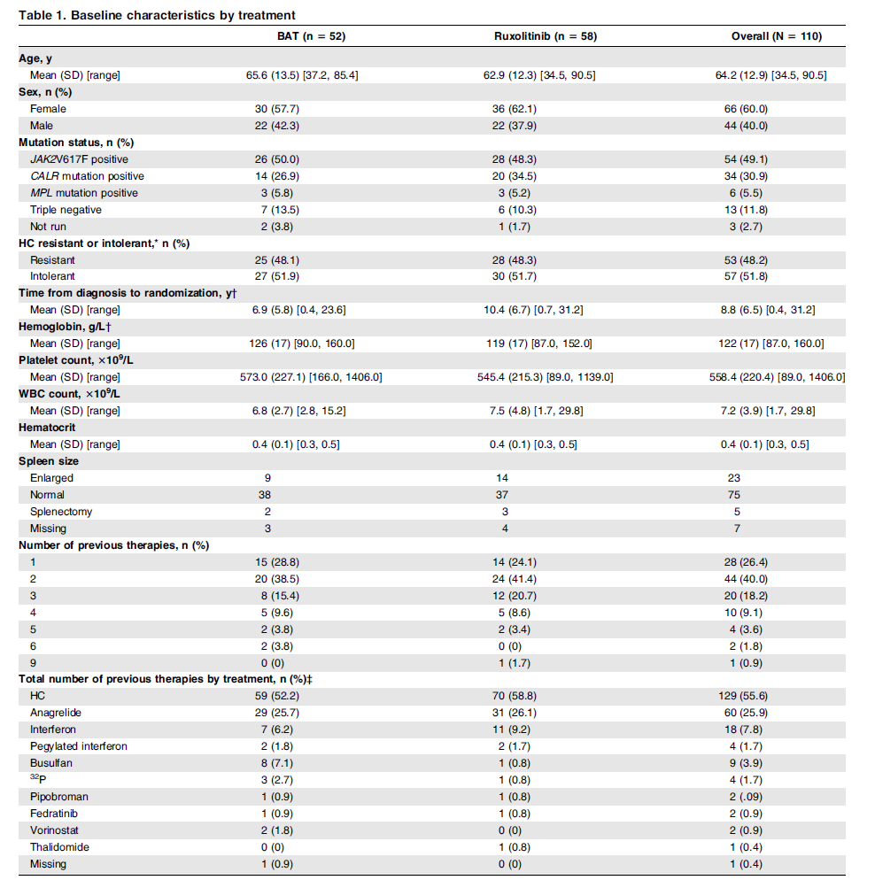
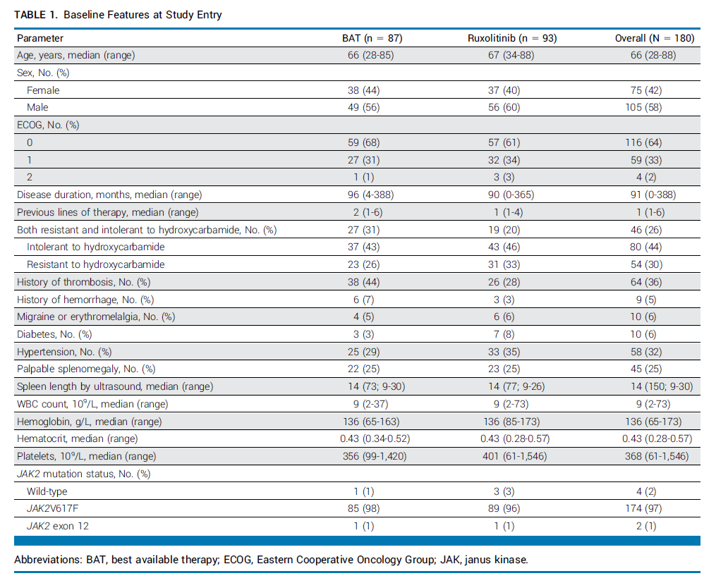
Covariate generating

Slide 12

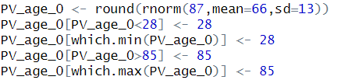
Covariate generating
For 0/1 variable, directly sample.
For continuous variable, use normal distribution and then truncated by the range. If the maximum (minimum) is less (larger) than the range value, set it to the range value.
For integer variable, directly sample.

Slide 13
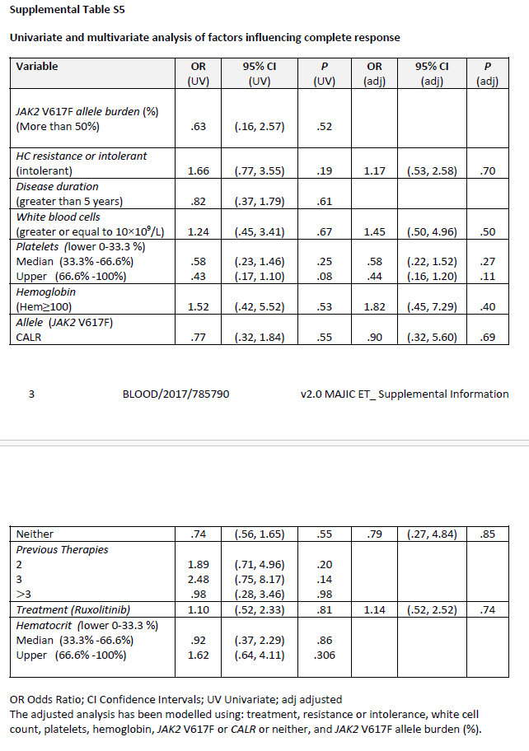
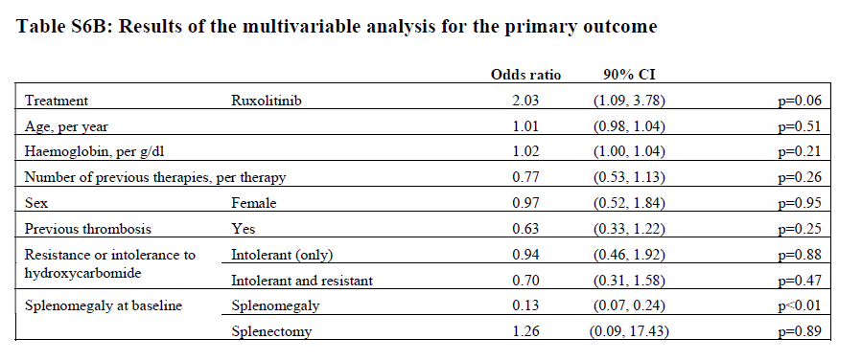
Outcome generating

Slide 14
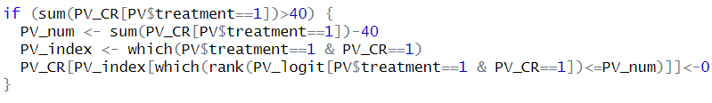
Outcome generating (PV)
Use the fitted logistic model to calculate the logit value (log odds ratio).
logit=intercept+treatment*log(2.03)+age*log(1.01)+haemoglobin*log(1.02)+therapy*log(0.77)+sex*log(0.97)+thrombosis*log(0.63)+intolerant*log(0.94)+ intoresis*log(0.7)+splemomegaly*log(0.13)+splenectomy*log(1.26)
Intercept is the overall log odds ratio: log(63/117)
Each covariate (including treatment) is centered.
Use p=exp(logit)/(1+exp(logit)) as the CR rate for each patients.
Use Bernoulli distribution to generate CR with probability p.
To make sure the response is consistent with the true observation, do some calibration.
For example, the total CR in treatment is 40. In generated data, if it is greater than 40, for example 45, then rank their probability, and choose the lowest 5 patients, make them CR=0.

Slide 15
Covariate conclusion
 | Generate outcome of PV | Generate outcome of ET | Covariate adjustment 1 | Covariate adjustment 2 | Covariate adjustment 3 | Covariate adjustment 4
Age | Y |  |  |  |  | Y
Sex | Y |  |  |  |  | Y
haemoglobin | Y | Y | Y |  | Y | Y
therapy | Y |  |  |  |  | Y
thrombosis | Y
intolerant | Y | Y |  | Y | Y | Y
splemomegaly | Y |  |  |  |  | Y
splenectomy | Y |  |  |  |  | Y
WBC |  | Y |  |  |  | Y
platelets |  | Y |  |  |  | Y
JAK2 mutation |  | Y |  |  |  | Y

Slide 16
Analysis
Four cases use different set of covariate shown in the last page.
Will report the density curve of the posterior samples from MCMC
Will report the posterior mean, standard deviation, 95% credible interval, and standard deviation reduction compared with unadjusted BHM.

Slide 17
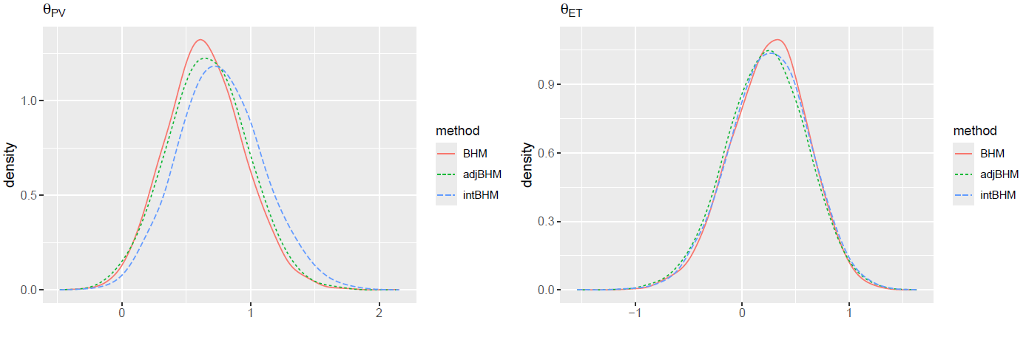
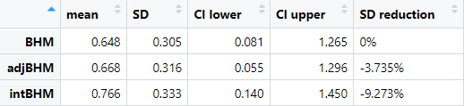
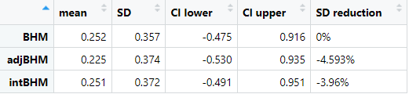
Result (intolerant only)

Slide 18
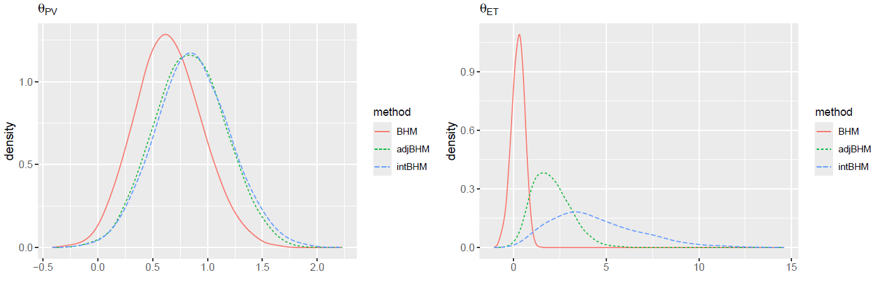
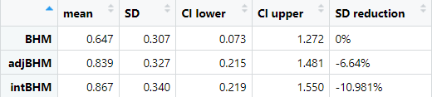
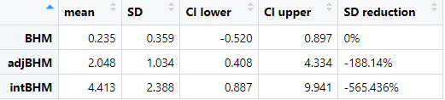
Result (haemoglobin only)

Slide 19
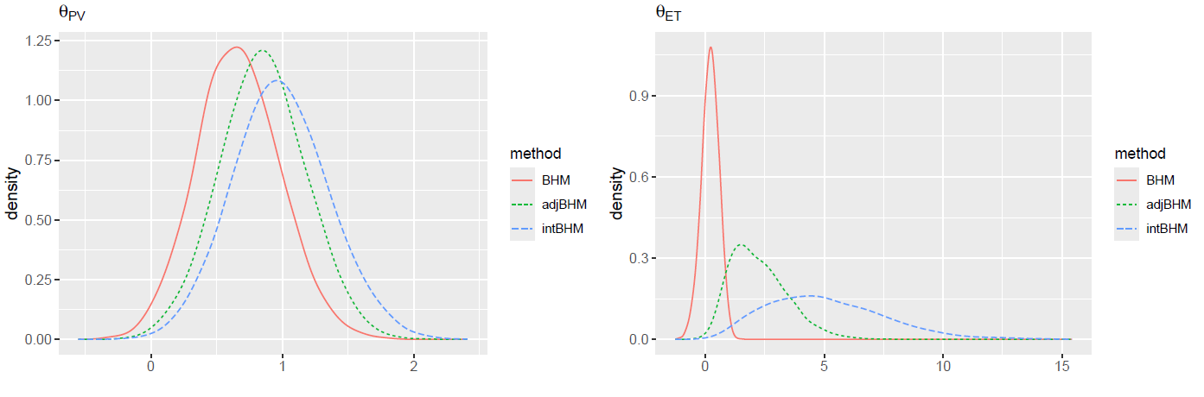
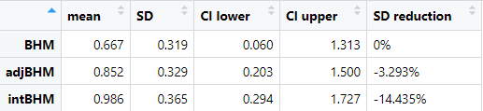
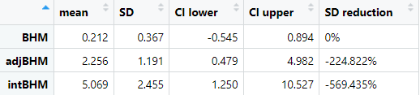
Result (haemoglobin + intolerant)

Slide 20
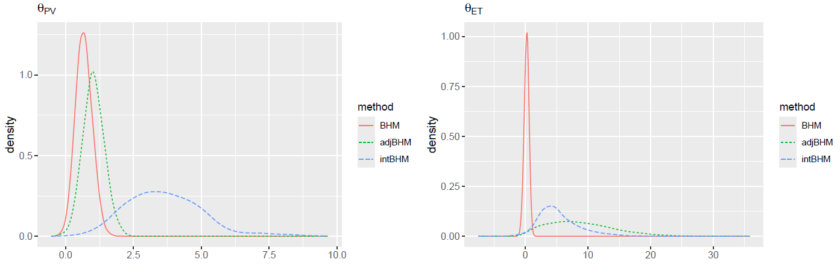
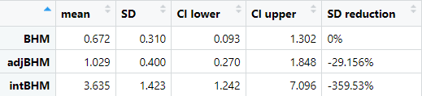
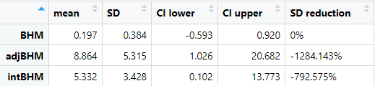
Result (all)

